Slide 1
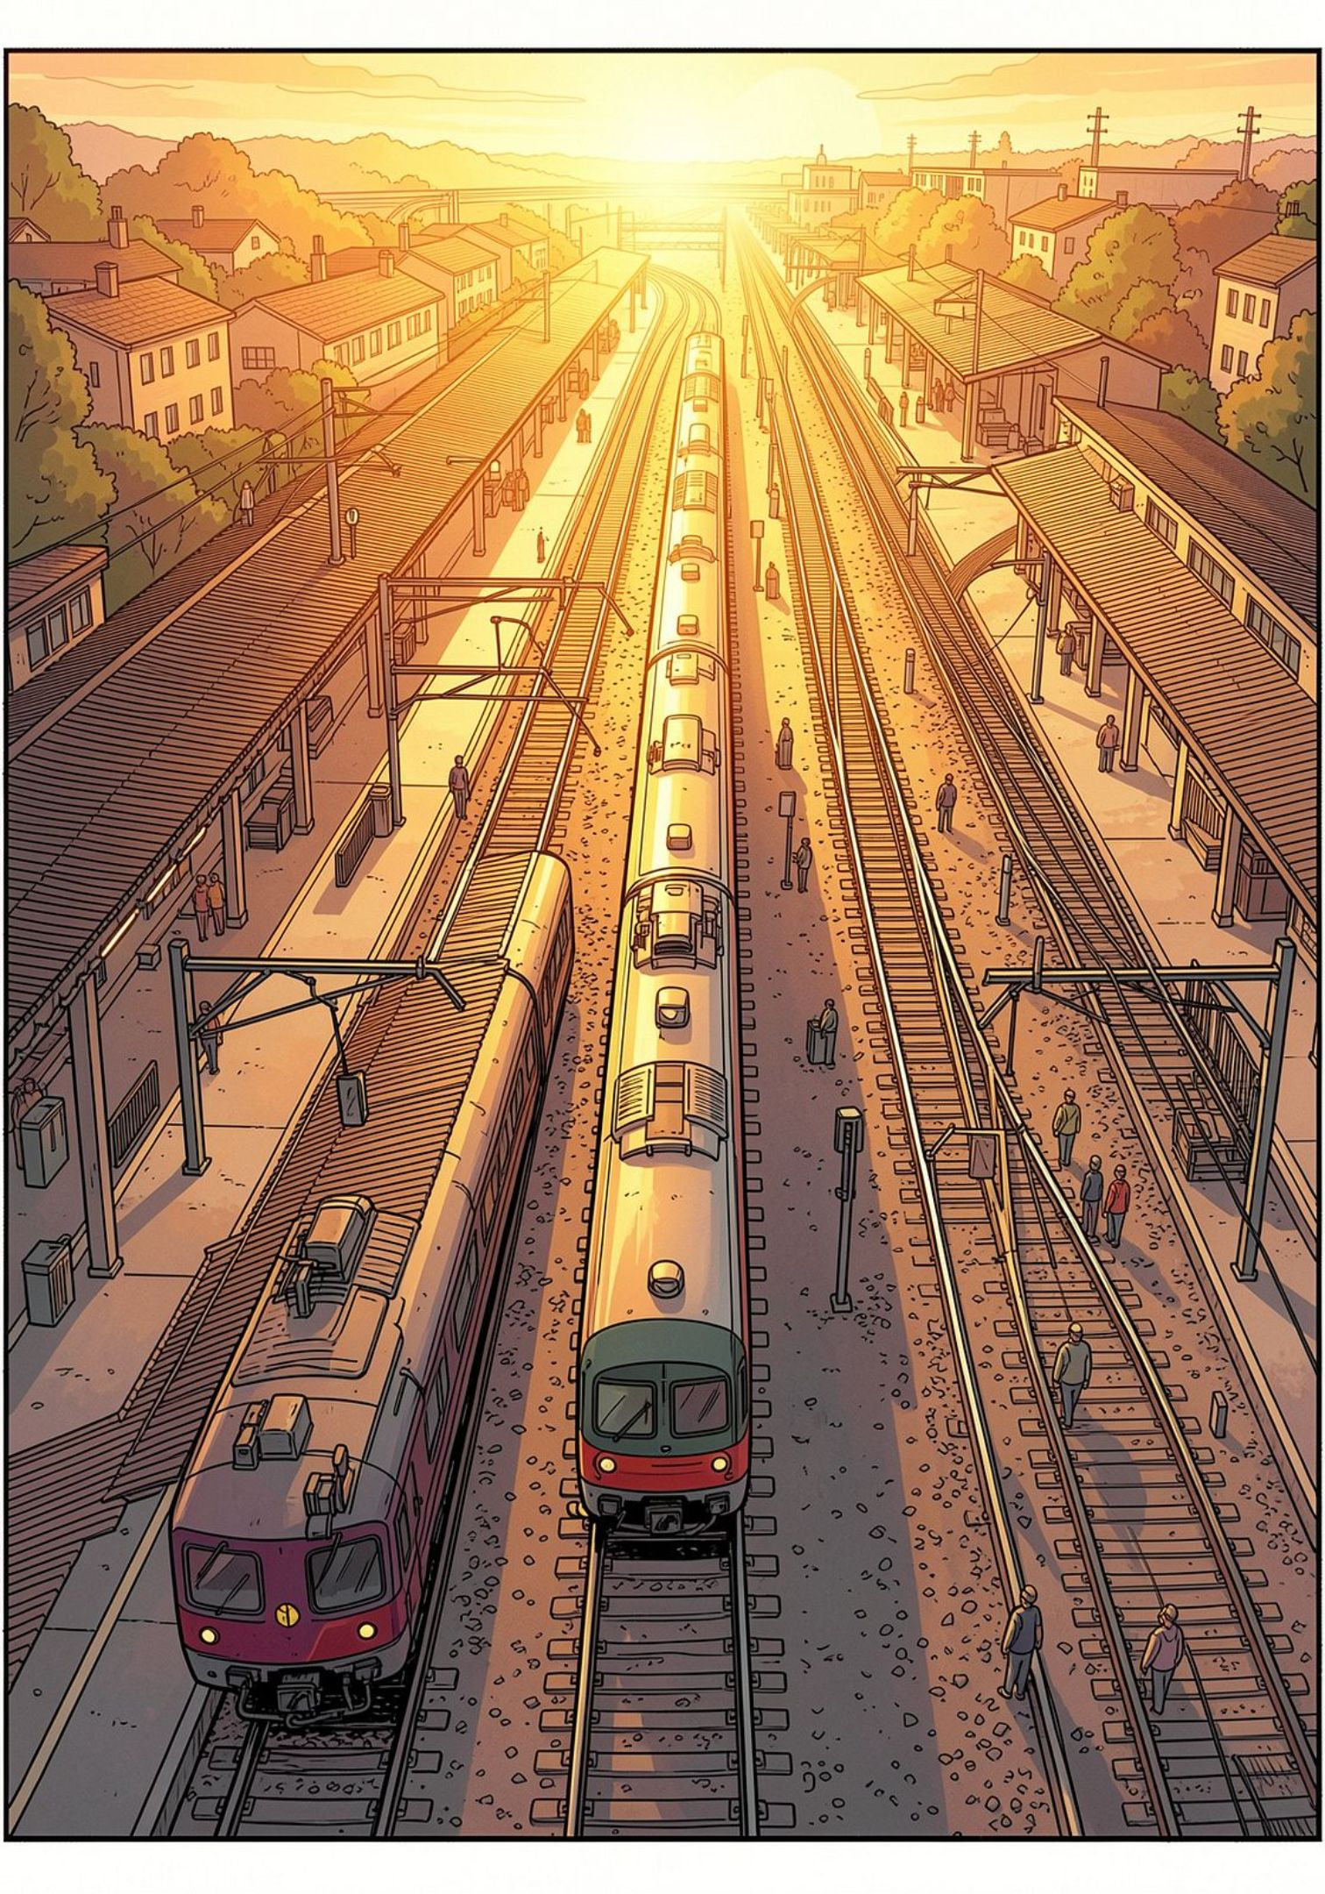
EDA & EDA Lab — Assignment #1
Seat Assignment Problem
Given m railway stations and n passenger tickets, design data structures and batch-processing algorithms to minimize the number of seats required while optimizing resource utilization across the train's full route.
ELECTRONIC DESIGN AUTOMATION
ALGORITHM DESIGN
UNDERGRADUATE LAB

Slide 2
What We'll Cover
01
02
Problem Setup
Three Solution Approaches
Initial state, constraints, and objectives of the seat assignment challenge.
Brute-Force, Difference Array, and Sweep-Line / Seat Packing — each with distinct trade-offs.
03
04
Results & Analysis
Comparison & Conclusion
Complexity analysis, seat count outcomes, and identified bottlenecks for each method.
Side-by-side evaluation and the combined strategy that delivers the optimal EDA solution.

Slide 3
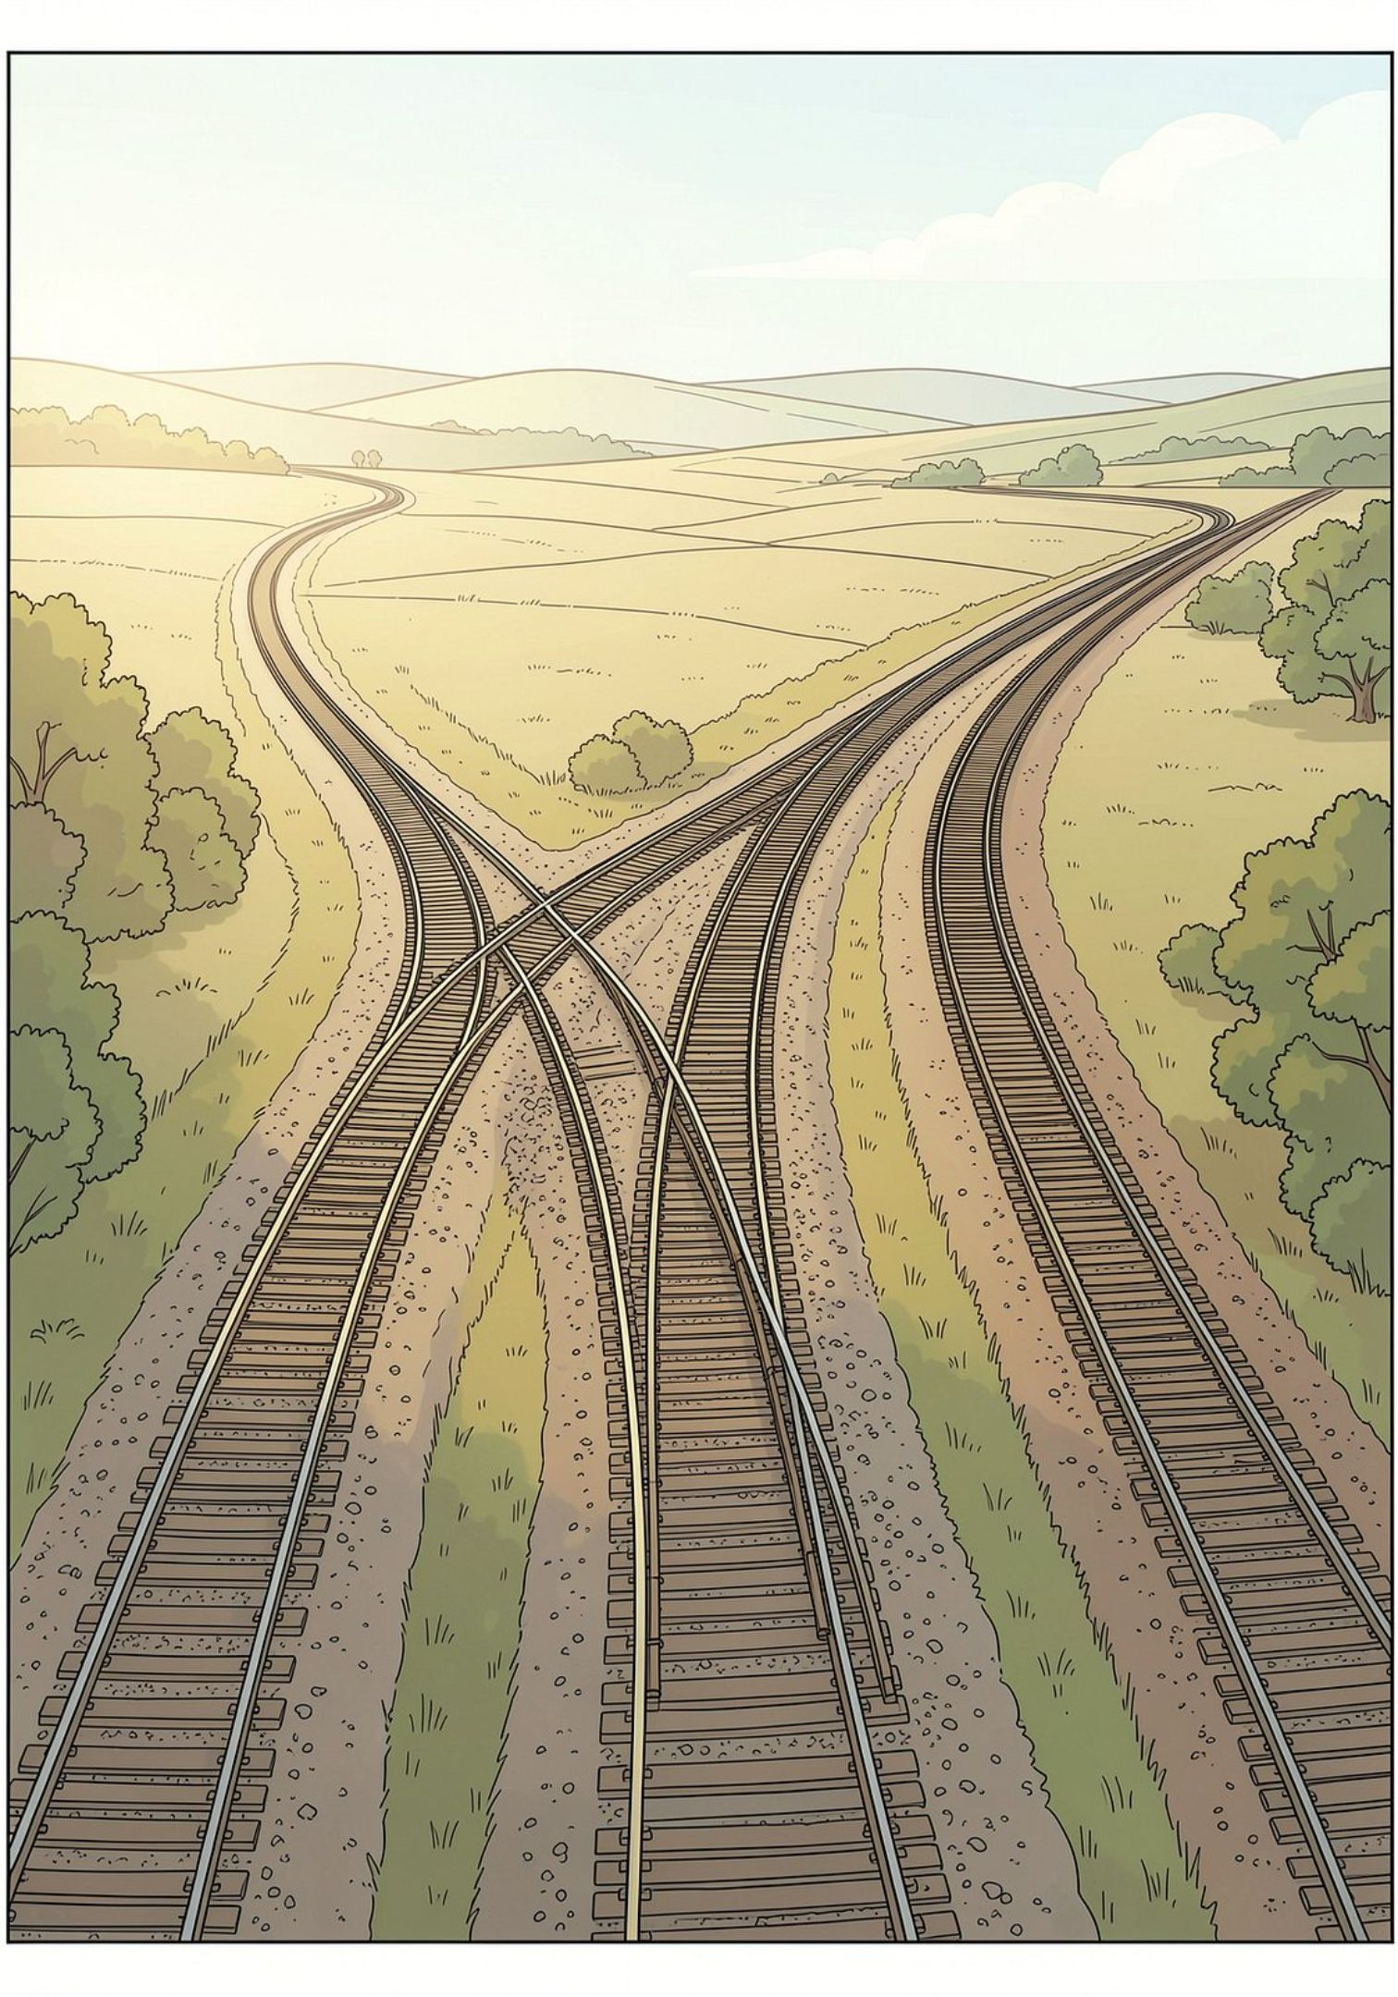
Three Approaches at a Glance
Approach 1 — Brute-Force
Approach 2 — Difference Array
Scan every station for every ticket. Simple but scales poorly: O(n · m).
Mark +1 at boarding and −1 at alighting, then compute cumulative load. Complexity: O(n + m).
Approach 3 — Sweep-Line
Sort tickets by start station and reuse freed seats greedily. Complexity: O(n log n).

Slide 4
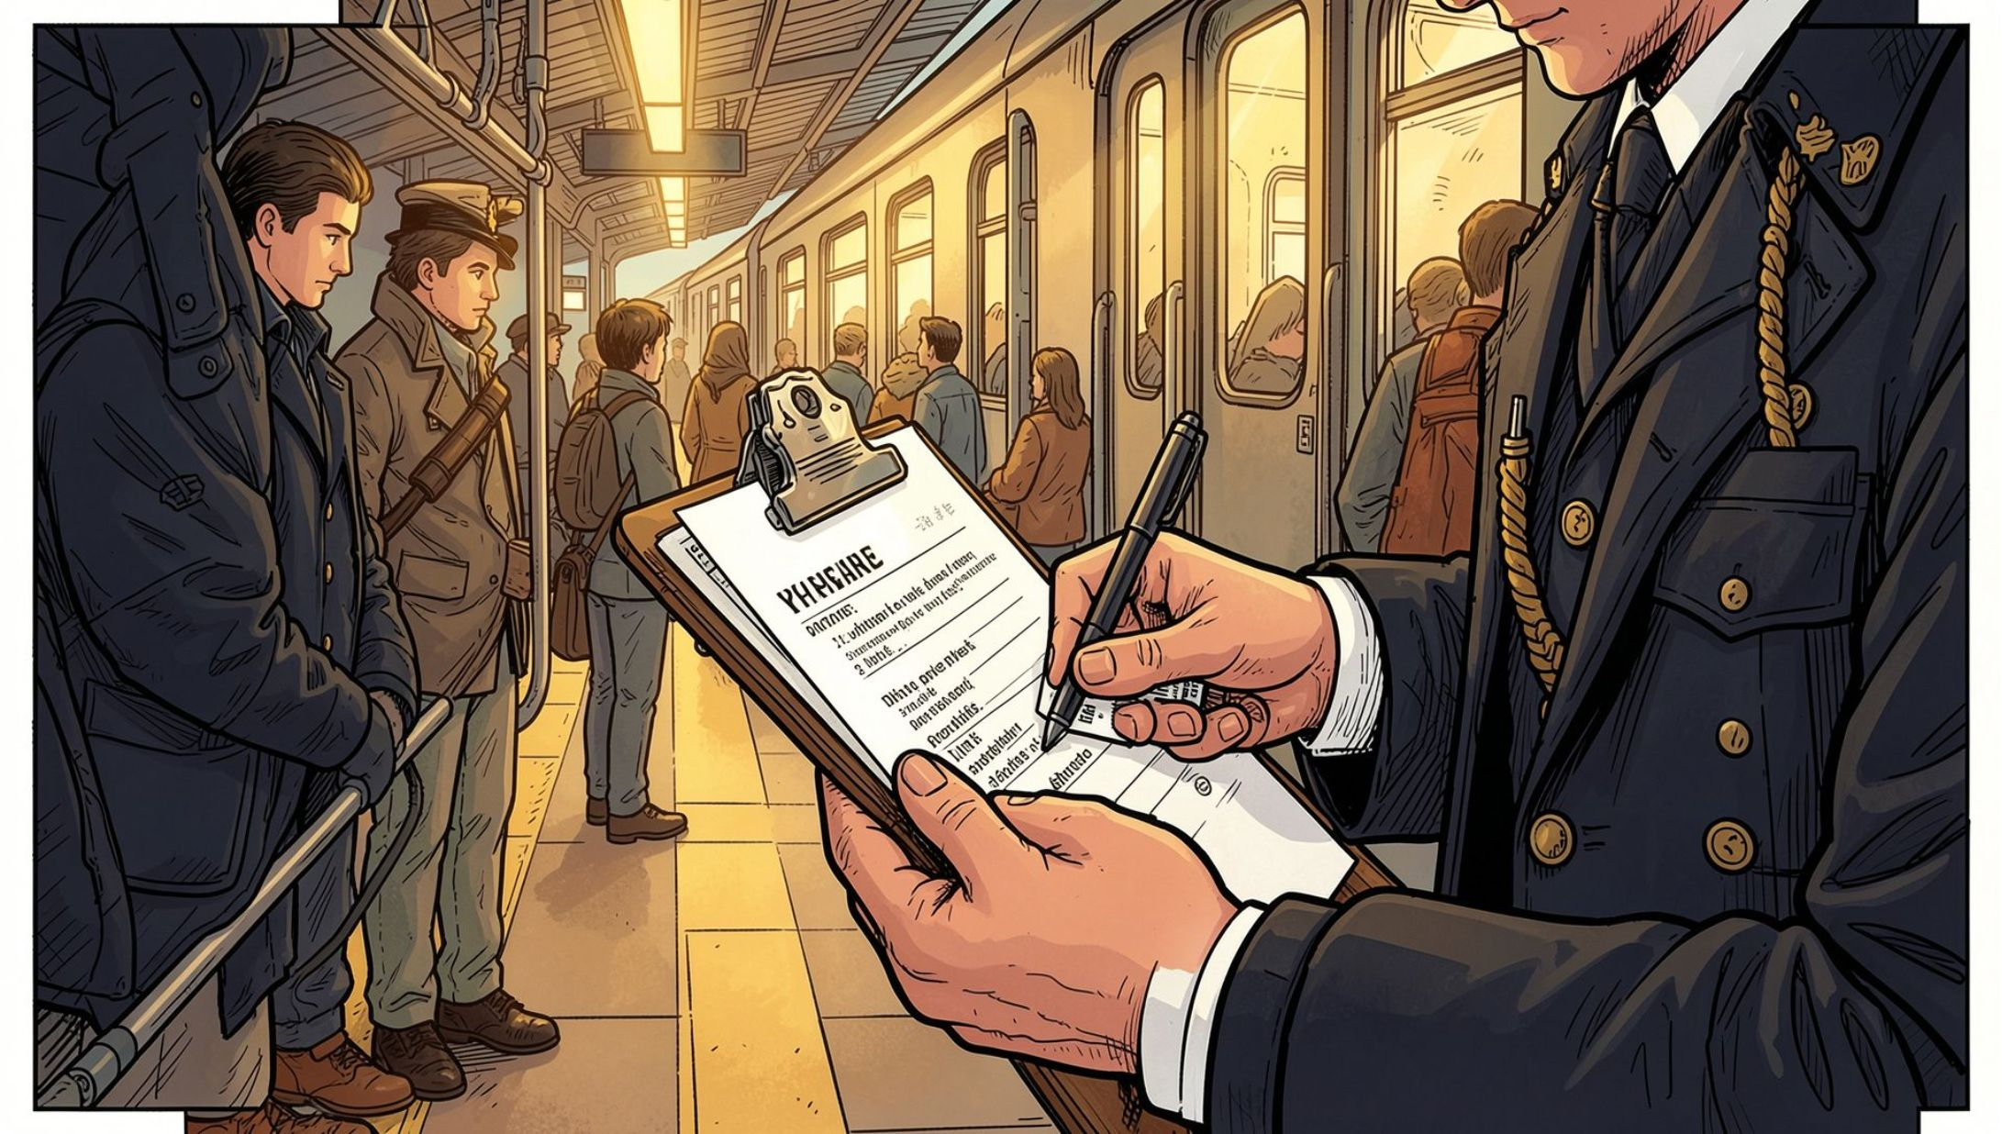

APPROACH 1
Brute-Force / Linear Station Scan
For each ticket, iterate through every station on the route and count how many passengers are present at each checkpoint. The maximum count across all stations equals the minimum seats needed.
Result
Limitation
Correctly identifies the peak seat requirement by exhaustively scanning all station checkpoints.
Time complexity O(n · m) — becomes prohibitively slow as ticket volumes or station counts grow in real-world EDA scenarios.

Slide 5
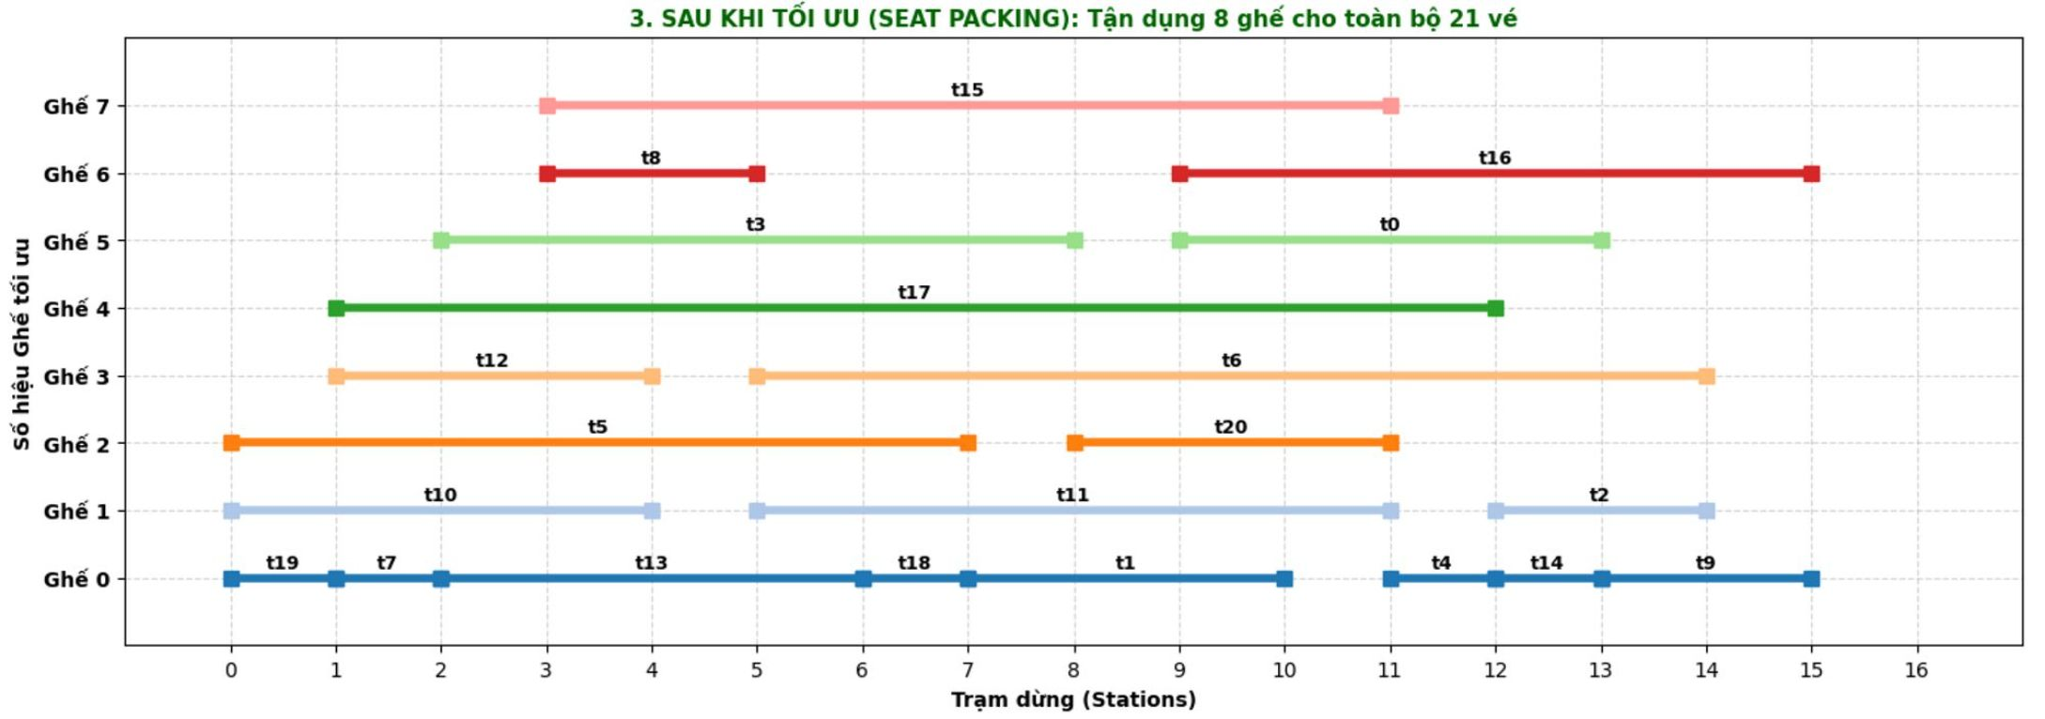
APPROACH 2
Difference Array / Load Analysis
How It Works
Initialize a difference array diff. For each ticket, add +1 at the boarding station and −1 at the alighting station. A single cumulative-sum sweep reveals passenger density across every track segment.
Key Results
Highest-density segment identified: between Station 3 and Station 4
Minimum seats required: 8 seats
Time complexity improved to O(n + m) — a dramatic gain over Approach 1

Slide 6
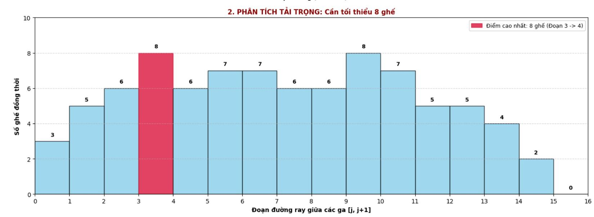
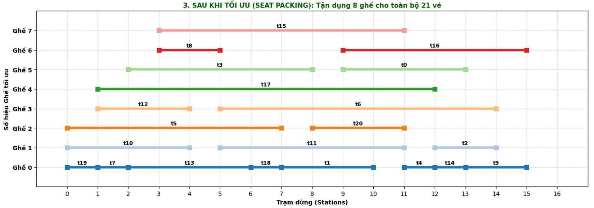
APPROACH 3
Sweep-Line / Seat Packing
Sort tickets by starting station in ascending order. For each ticket, check existing seats — if a seat's free_time ≤ start, reuse it; otherwise allocate a new seat.
21 Tickets Packed
Visual Seat Map
O(n log n)
All assigned to exactly 8 optimal seats (Seat 0–7) with zero timing conflicts.
Each ticket's schedule is mapped to a specific seat, enabling full traceability.
Sorting dominates; seat reuse is linear — highly efficient at scale.

Slide 7
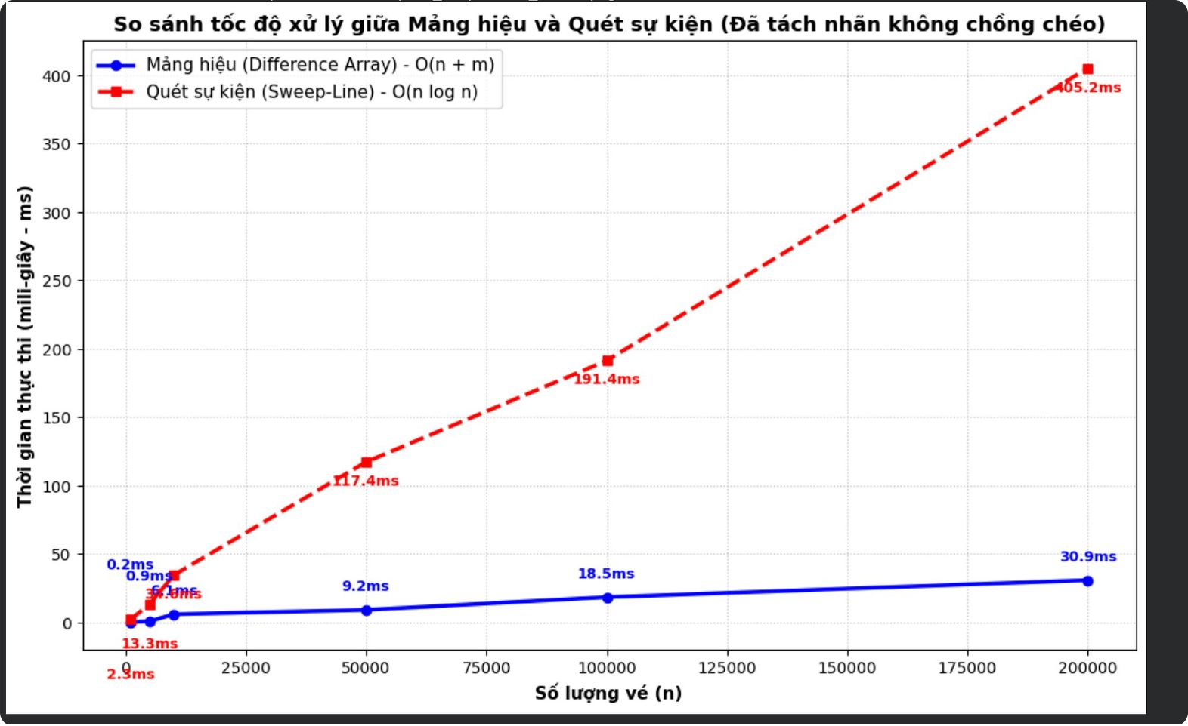

Comparison & Conclusion
Approach | Complexity | Strength | Weakness
Brute-Force | O(n·m) | Simple to implement | Too slow at scale
Difference Array | O(n+m) | Fastest peak-load detection | No per-ticket seat map
Sweep-Line | O(n log n) | Full seat assignment | Requires sorting step
Best Practice: Combine Approach 2 (load analysis) with Approach 3 (seat packing) for a complete, optimal EDA solution — fast peak detection plus precise per-passenger assignment.

